Slide 1
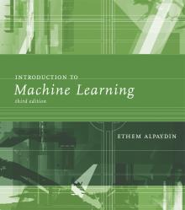
INTRODUCTION TO Machine Learning 3rd Edition
Lecture Slides for
ETHEM ALPAYDIN
© The MIT Press, 2014
alpaydin@boun.edu.tr
http://www.cmpe.boun.edu.tr/~ethem/i2ml3e

Slide 2
CHAPTER 3: Bayesian Decision Theory

Slide 3
Probability and Inference
In ML, data comes from the source with an unknown process.
This lack of knowledge compels us to model this process as a random process and apply statistics and probability theory.
Having a complete knowledge dissolves the need of probability theory and makes a process deterministic.

Slide 4
Probability and Inference
The unknown knowledge is called unobservable variable.
The known knowledge is observable variable.
Why tossing a coin is a random process?
What are the observable variable?
What are the unobservable variables?

Slide 5
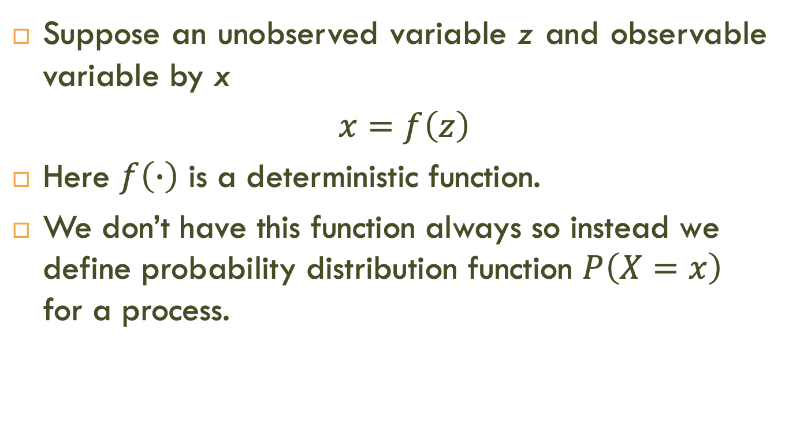
Probability and Inference
Suppose an unobserved variable z and observable variable by x
$x=f\left(z\right)$
Here $f\left(∙\right)$ is a deterministic function.
We don’t have this function always so instead we define probability distribution function $P\left(X=x\right)$ for a process.

Slide 6
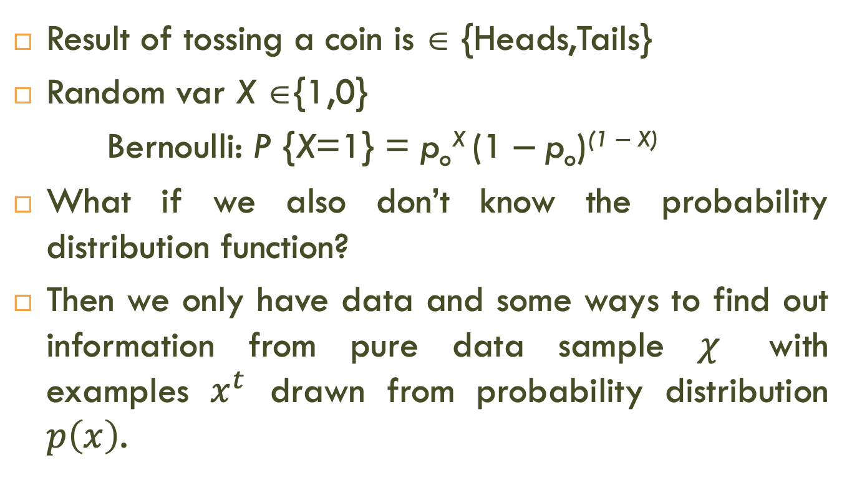
Probability and Inference
Result of tossing a coin is ∈ {Heads,Tails}
Random var X ∈{1,0}
Bernoulli: P {X=1} = p_{o}^{X} (1 ‒ p_{o})^{(1 ‒ X)}
What if we also don’t know the probability distribution function?
Then we only have data and some ways to find out information from pure data sample $χ$ with examples $x^{t}$ drawn from probability distribution $p\left(x\right)$.

Slide 7
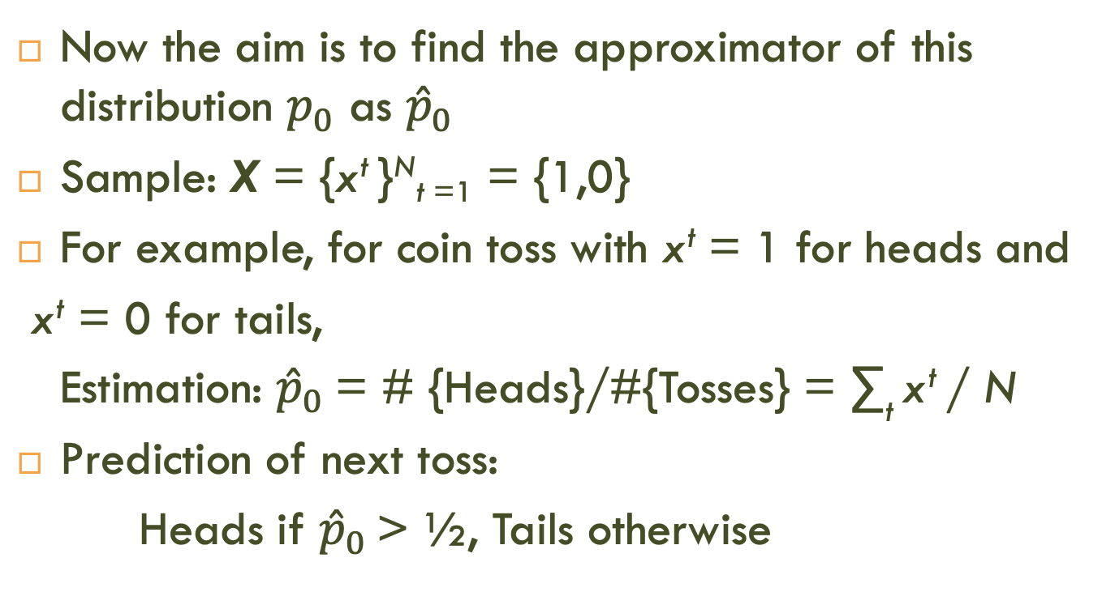
Probability and Inference
Now the aim is to find the approximator of this distribution $p_{0}$ as ${\hat{p}}_{0}$
Sample: X = {x^{t} }^{N}_{t =1} = {1,0}
For example, for coin toss with x^{t} = 1 for heads and
x^{t} = 0 for tails,
Estimation: ${\hat{p}}_{0}$= # {Heads}/#{Tosses} = ∑_{t} x^{t} / N
Prediction of next toss:
Heads if ${\hat{p}}_{0}$ > ½, Tails otherwise

Slide 8
Classification
Example: Credit scoring: Inputs (observables) are income and savings.
Output (observable) is low-risk vs high-risk
Input: x = [x₁,x₂]^{T} , Output: C = {0,1}
What can be unobservable variables?

Slide 9
Classification
Example: Credit scoring: Inputs (observables) are income and savings.
Output (observable) is low-risk vs high-risk
Input: x = [x₁,x₂]^{T} , Output: C = {0,1}
Prediction:

Slide 10
Bayes’ Rule
prior
likelihood
posterior
evidence

Slide 11
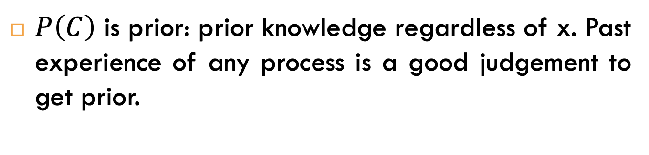
Bayes’ Rule
prior
likelihood
posterior
evidence
$P\left(C\right)$ is prior: prior knowledge regardless of x. Past experience of any process is a good judgement to get prior.

Slide 12
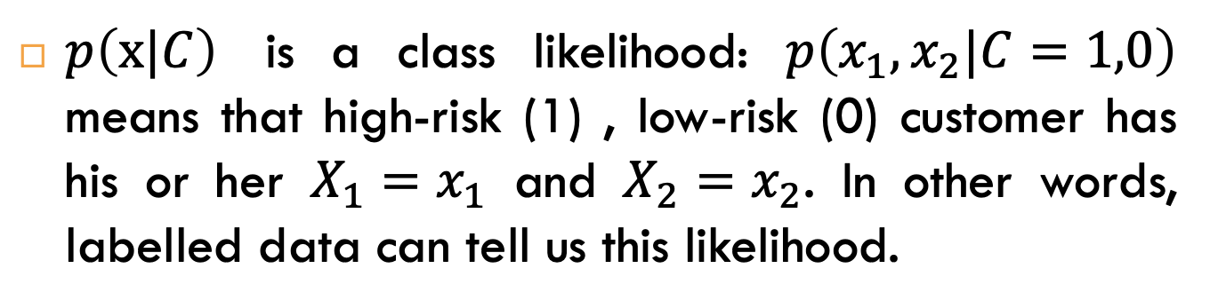
Bayes’ Rule
prior
likelihood
posterior
evidence
$p\left(x|C\right)$ is a class likelihood: $p\left(x_{1},x_{2}|C=1,0\right)$ means that high-risk (1) , low-risk (0) customer has his or her $X_{1}=x_{1}$ and $X_{2}=x_{2}$. In other words, labelled data can tell us this likelihood.

Slide 13
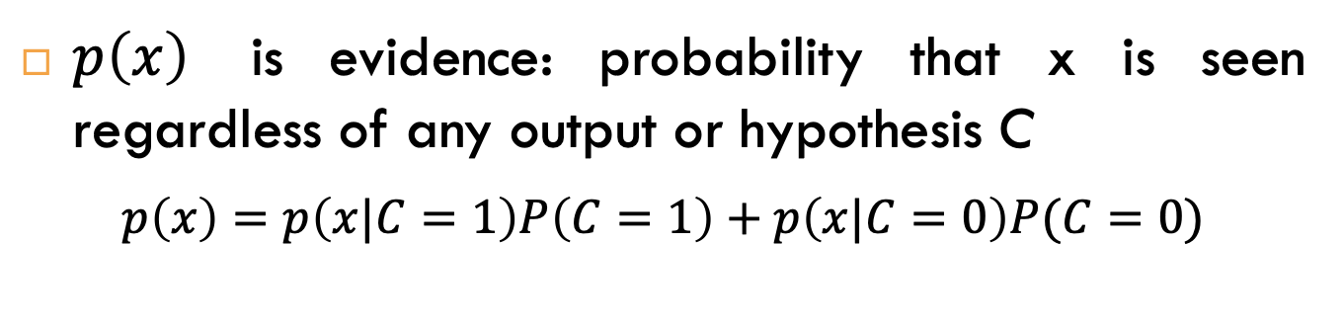
Bayes’ Rule
prior
likelihood
posterior
evidence
$p\left(x\right)$ is evidence: probability that x is seen regardless of any output or hypothesis C
$p\left(x\right)=p\left(x|C=1\right)P\left(C=1\right)+p\left(x|C=0\right)P(C=0)$

Slide 14
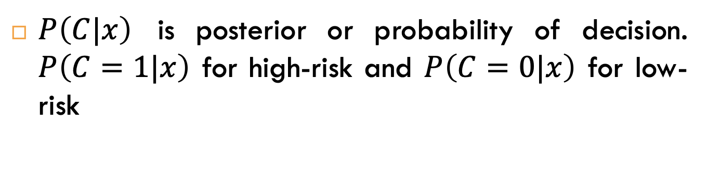
Bayes’ Rule
prior
likelihood
posterior
evidence
$P\left(C|x\right)$ is posterior or probability of decision. $P\left(C=1|x\right)$ for high-risk and $P\left(C=0|x\right)$ for low-risk

Slide 15
Bayes’ Rule
prior
likelihood
posterior
evidence
To sum up, Bayes’ rule takes initial belief (prior) and also incorporate evidence and then makes a revised decision (posterior).

Slide 16
Bayes’ Rule Example-1
Find out that in a new judicial case, the defendant is innocent by checking the blood type. With the past experience, the judge knows that about 40% of cases are innocent. Suppose the blood type of defendant is found in 1 out of 10 people if innocent and in 95% of cases when the defendant is guilty, the blood type matches.

Slide 17
Bayes’ Rule Example-2
Find out that a new case is COVID-19 +ve by using PCR diagnosis test. With experience it is found that 2 out of 100 people were covid +ve and 85% of covid +ve people have positive PCR test. The false positive rate of PCR test is 5%.

Slide 18
Bayes’ Rule: K>2 Classes

Slide 19
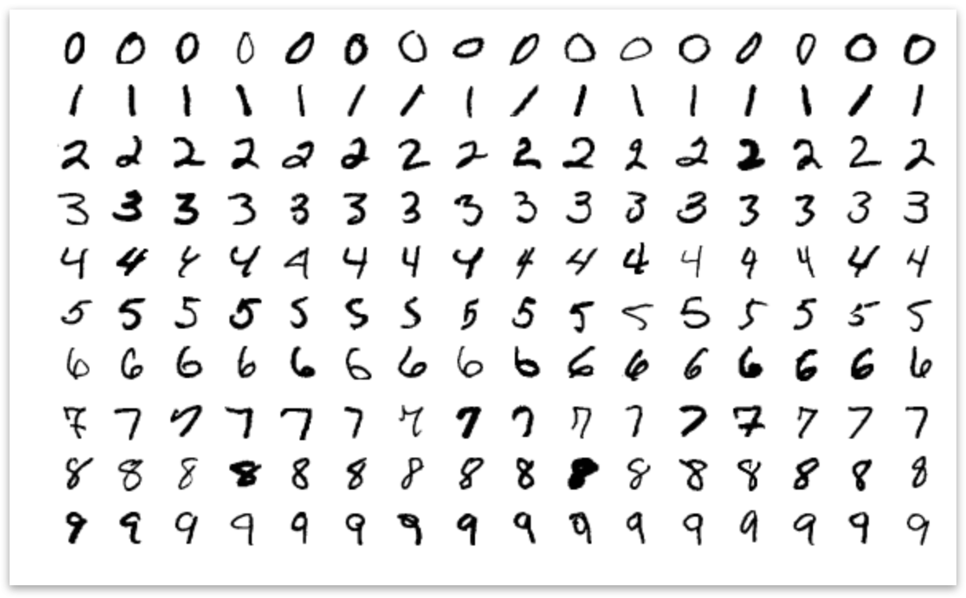
Bayes’ Rule: K>2 Classes
Example: Digit Classification
No. of Classes = 10

Slide 20
Losses and Risks
Actions: α_{i}
Loss of α_{i} when the state is C_{k} : λ_{ik}
Expected risk (Duda and Hart, 1973)

Slide 21
Losses and Risks: 0/1 Loss
For minimum risk, choose the most probable class

Slide 22
Losses and Risks: Reject

Slide 23


Losses and Risks: Reject
$$Choose C_{i} if R\left(α_{i}|x\right)<R\left(α_{k}|x\right) ∀ i≠k$$
$$AND R\left(α_{i}|x\right)<R\left(α_{K+1}|x\right)$$
$$Reject if R\left(α_{K+1}|x\right)<R\left(α_{i}|x\right), i=1,2,3,…K$$

Slide 24
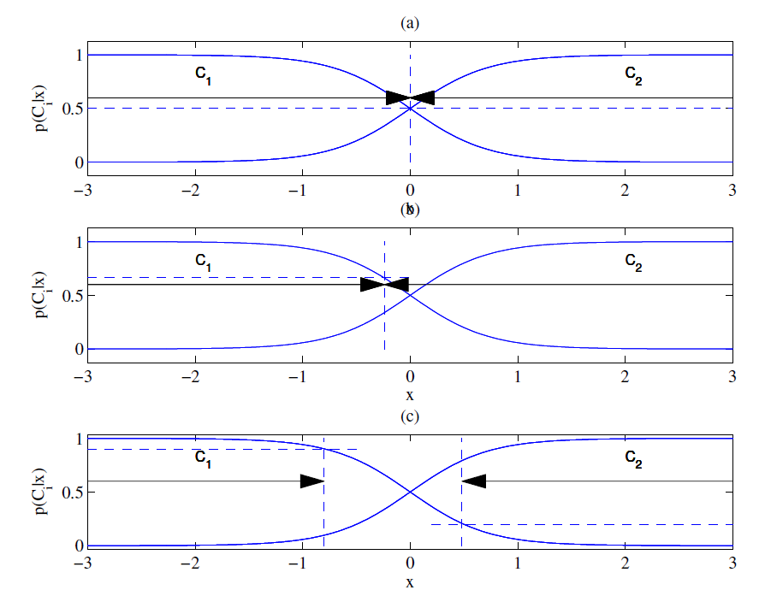
Different Losses and Reject
Equal losses
Unequal losses
With reject

Slide 25
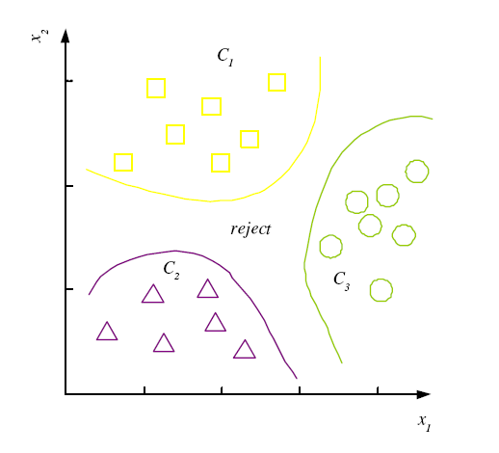
Discriminant Functions
K decision regions R₁,...,R_{K}

Slide 26
K=2 Classes
Dichotomizer (K=2) vs Polychotomizer (K>2)
g(x) = g₁(x) – g₂(x)
Log odds:

Slide 27
Association Rules
Association rule: X → Y
People who buy/click/visit/enjoy X are also likely to buy/click/visit/enjoy Y.
A rule implies association, not necessarily causation.

Slide 28
Association measures
Support (X → Y):
Confidence (X → Y):
Lift (X → Y):

Slide 29
Apriori algorithm (Agrawal et al., 1996)
For (X,Y,Z), a 3-item set, to be frequent (have enough support), (X,Y), (X,Z), and (Y,Z) should be frequent.
If (X,Y) is not frequent, none of its supersets can be frequent.
Once we find the frequent k-item sets, we convert them to rules: X, Y → Z, ...
and X → Y, Z, ...

Slide 30
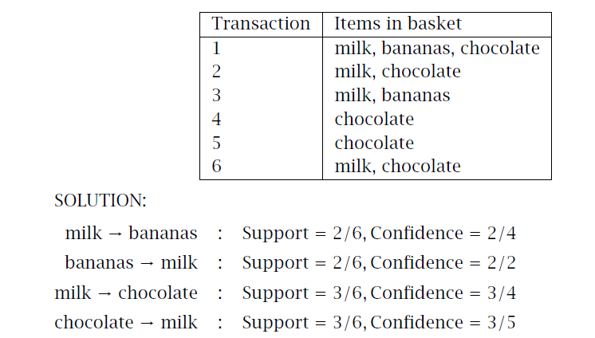
Exercise-1

Slide 31
Exercise-2

Slide 32
Exercise-3

Slide 33
Exercise-4

